Slide 1
F28DM Database Management Systems
Query Optimisation
Monica Farrow
monica@macs.hw.ac.uk
Room: EMG30, Ext: 4160
Material on Vision & my web page
Content taken from HW lecturers,
+ books by Rob & Coronel, and by Connolly & Begg

Slide 2
Relational Operators recap
Selection σ
  Selects a subset of rows from a relation
Projection π
  Deletes unwanted columns from a relation
Join |X|
  Allows us to combine 2 relations

Slide 3
Relational Algebra Select recap
SELECT *
FROM Sailor
WHERE rating = 7;
The RA select operator obtains just those rows which satisfy the condition
NOT the same as
SQL select
id | name | rating | age
22 | Dustin | 7 | 45
31 | Lubber | 8 | 55
42 | Jack | 7 | 22
58 | Rusty | 10 | 35
S1 <= σ rating = 7 (Sailor)
id | name | rating | age
22 | Dustin | 7 | 45
42 | Jack | 7 | 22

Slide 4
Relational Algebra Project recap
SELECT name
FROM Sailor. . .
The RA project operator obtains just those named columns
id | name | rating | age
22 | Dustin | 7 | 45
42 | Jack | 7 | 22
Πname(S1 )
name
Dustin
Jack

Slide 5
Relational Algebra Cartesian product recap
SELECT day FROM Sailor , Reservation
WHERE rating = 7;
The RA Cartesian Product operator creates one table consisting of each row from one table linked with each row from the other table.
  No room to show much of this.
  It is not often meaningful
Sailor X Reservation
id | name | rating | age | sid | bid | day
22 | Dustin | 7 | 45 | 22 | 101 | 10/10/96
22 | Dustin | 7 | 45 | 22 | 102 | 11/09/97
22 | Dustin | 7 | 45 | 58 | 103 | 11/12/96
31 | Lubber | 8 | 55 | 22 | 101 | 10/10/96
31 | Lubber | 8 | 55 | 22 | 102 | 11/09/97
etc

Slide 6
Relational Algebra Natural Join recap
SELECT* FROM Sailor , Reservation
WHERE Sailor.id = Reservation.sid;
The RA natural join operator is a Cartesian Product combined with a selection over common attributes. These common attributes are removed from the resulting table.
id | name | rating | age
22 | Dustin | 7 | 45
31 | Lubber | 8 | 55
42 | Jack | 7 | 22
58 | Rusty | 10 | 35
sid | bid | day
22 | 101 | 10/10/96
22 | 102 | 11/09/97
58 | 103 | 11/12/96
Sailor |X| _{id = sid} Reservation
id | name | rating | age | bid | day
22 | Dustin | 7 | 45 | 101 | 10/10/96
22 | Dustin | 7 | 45 | 102 | 11/09/97
58 | Rusty | 10 | 35 | 103 | 11/12/96

Slide 7
Introduction to Query Optimisation
With declarative languages such as SQL, the user specifies what data is required
  E.g. SELECT name FROM Sailor WHERE rating =7;
rather than how it is to be retrieved.
  E.g. RA select
  RA project
  Π_{name}(σ _{rating = 7} (Sailor) )
This relieves user of knowing what constitutes good execution strategy.
It also gives DBMS more control over system performance.
© Pearson Education Limited 1995, 2005

Slide 8
Query Processing
Query Processing encompasses all the activities involved in retrieving data from the database.
Aims of QP:
  Transform query written in high-level language (e.g. SQL), into a correct and efficient execution strategy expressed in low-level language (implementing RA);
  Execute the strategy to retrieve the required data.
© Pearson Education Limited 1995, 2005

Slide 9
Phases of Query Processing
QP has four main phases:
  decomposition (consisting of parsing and validation) and finally transforming the query into a RA tree;
  optimization;
  code generation;
  execution.
© Pearson Education Limited 1995, 2005

Slide 10
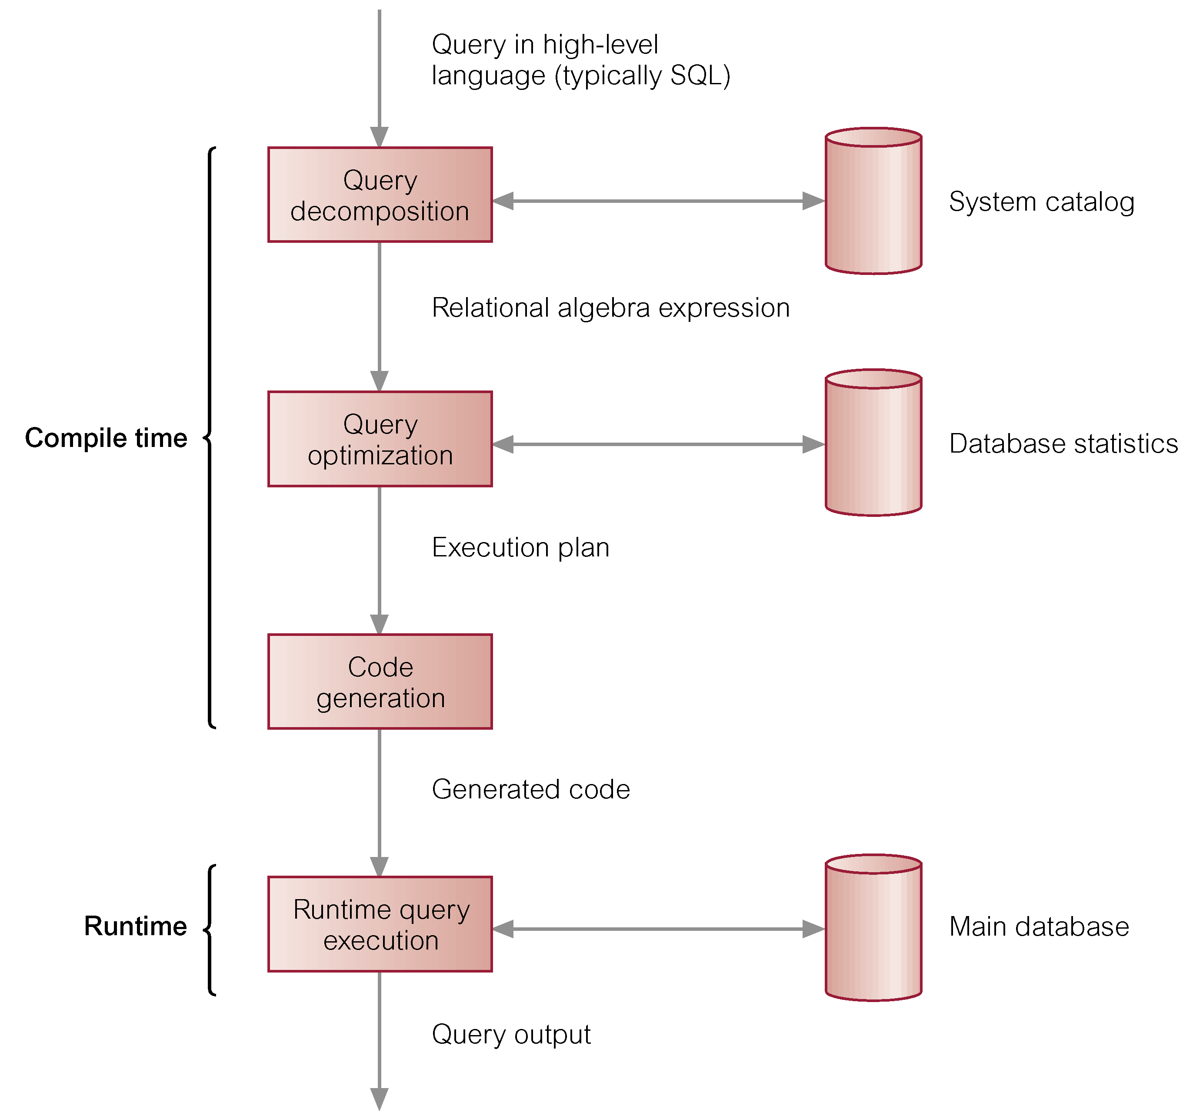
Phases of Query Processing
© Pearson Education Limited 1995, 2005

Slide 11
Query Optimisation
Query Optimisation is the activity of choosing an efficient execution strategy for processing query.
There will be many equivalent transformations of the same high-level query. The aim of QO is to choose one that minimizes resource usage.
  Generally, reduce total execution time of query.
  May also reduce response time of query.
The problem is computationally intractable with a large number of relations, so the strategy adopted is reduced to finding a near optimum solution.
© Pearson Education Limited 1995, 2005

Slide 12
Two techniques
There are 2 main techniques for query optimization:
  Heuristic rules that order operations in a query;
  Comparing different strategies based on relative costs, and selecting one that minimizes resource usage.
Disk access tends to be the dominant cost in query processing in a DBMS.
© Pearson Education Limited 1995, 2005

Slide 13
Transforming the query into a query tree
Transform the query into a query tree
  Leaf node created for each base relation.
  Non-leaf node created for each intermediate relation produced by RA operation.
  Root of tree represents query result.
  Sequence is directed from leaves to root
© Pearson Education Limited 1995, 2005

Slide 14
Relational algebra tree
SELECT * FROM Staff s, Branch b
WHERE s.branchNo = b.branchNo
AND s.position = ‘Manager’ AND b.city=‘London’ ;
σ b.city=‘London’
σ s.position = ‘Manager’
σ s.branchNo = b.branchNo
X
Staff
Branch
© Pearson Education Limited 1995, 2005

Slide 15
Transformation Rules for RA Operations
The query tree can be transformed to become more efficient, following a set of transformation rules.
Here are 2 examples
σ_{lName='Beech'}(Π_{fName,lName} (Staff)) =
Π_{fName,lName} (σ_{lName='Beech'} (Staff))
  Staff |X| staff.branchNo=branch.branchNo Branch =
  Branch |X| staff.branchNo=branch.branchNo Staff
Applying the rules gives us a more efficient tree
© Pearson Education Limited 1995, 2005

Slide 16
Heuristical Processing Strategies
Perform Selection operations as early as possible.
Combine Cartesian product with the appropriate Selection to form a Natural Join operation.
Use associativity of binary operations to rearrange leaf nodes so leaf nodes with the most restrictive Selection operations are executed first
  Cut down the number of rows involved.
© Pearson Education Limited 1995, 2005

Slide 17
Heuristical Processing Strategies
Perform Projection as early as possible.
  Cut down the number of columns involved
Compute common expressions once.
  If common expression appears more than once, and result not too large, store result and reuse it when required.
  Useful when querying views, as same expression is used to construct view each time.
© Pearson Education Limited 1995, 2005

Slide 18
Relational algebra tree - improved
The selections have been done first to reduce the number of rows involved in the join.
The join and related WHERE condition have been recognised as a natural join
|X| s.branchNo = b.branchNo
σ s.position = ‘Manager’
σ b.city=‘London’
Staff
Branch
© Pearson Education Limited 1995, 2005

Slide 19
Another transformation
This is the query.
For prospective renters of flats, find properties that match requirements and owned by CO93.
  SELECT p.propertyNo, p.street
  FROM Client c, Viewing v, PropertyForRent p
  WHERE c.prefType = ‘Flat’ AND
  c.clientNo = v.clientNo AND
  v.propertyNo = p.propertyNo AND
  c.maxRent >= p.rent AND
  c.prefType = p.type AND
  p.ownerNo = ‘CO93’;
© Pearson Education Limited 1995, 2005

Slide 20
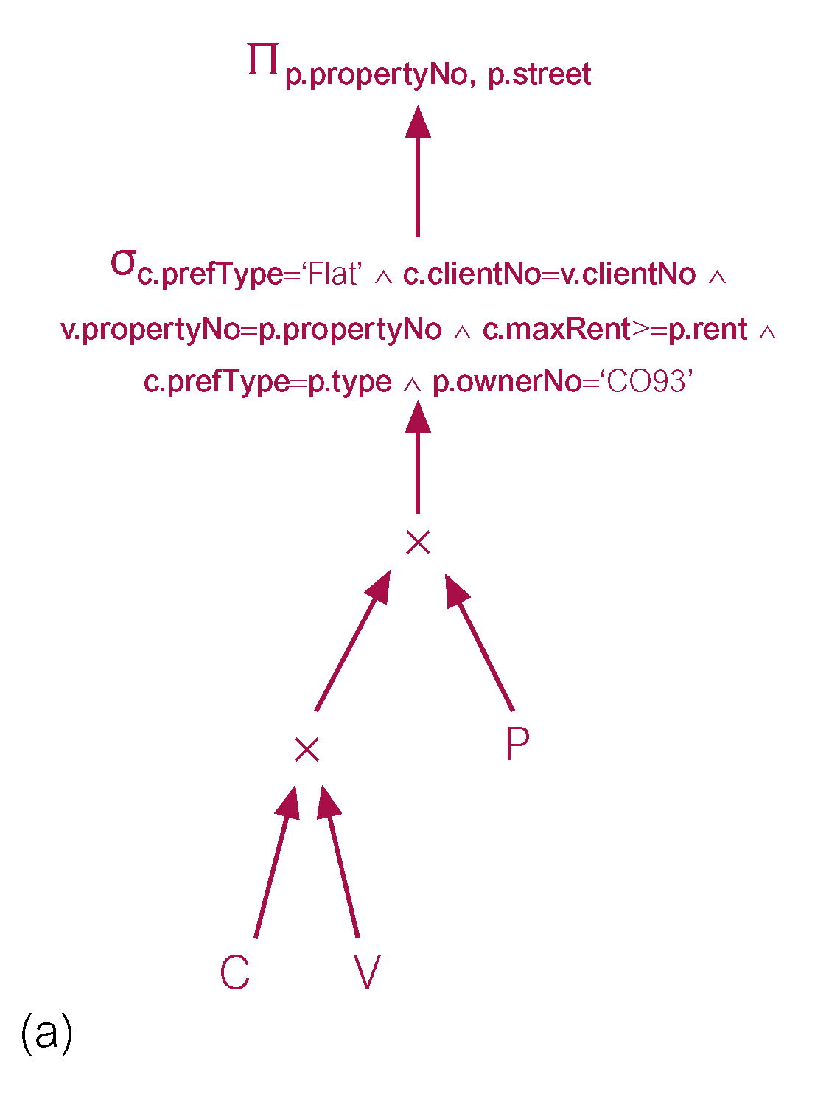
Exampl
Initially, do all joins first,
Then selection,
then projection
Just as in the SQL
© Pearson Education Limited 1995, 2005

Slide 21
Transformation challenge
Using common sense and the heuristic processing strategies, transform the query tree, shown on the previous slide, to be more efficient
  Recognise natural joins
  Minimise rows and columns wherever possible, partly by moving selections and projections down

Slide 22
COST ESTIMATION for RA Operations
There are many different ways of implementing RA operations.
The aim of QO is to choose the most efficient one.
  Use formulae that estimate costs for a number of options, and select one with lowest cost.
  Consider only cost of disk access, which is usually dominant cost in QP.
  Many estimates are based on cardinality of the relation (i.e. how many), so need to be able to estimate this.
© Pearson Education Limited 1995, 2005

Slide 23
Database Statistics
Success of estimation depends on amount and currency of statistical information DBMS holds.
Keeping statistics current can be problematic.
  If statistics updated every time a tuple is changed, this would impact on performance.
DBMS could update statistics on a periodic basis, for example nightly, or whenever the system is idle.
© Pearson Education Limited 1995, 2005

Slide 24
Updating Statistics
Here are typical statistics kept
  For a relation
    Number of tuples, number of tuples per block, number of blocks
  For an attribute
    Number of distinct values, min, mix,
    Selection cardinality – avg num of records satisfying an equality condition
  For an index
    Number of levels, number of leaf blocks
© Pearson Education Limited 1995, 2005

Slide 25
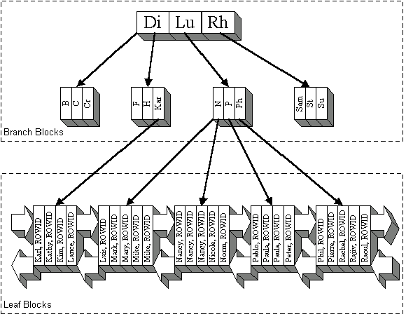
B-tree index recap
Quicker to search a tree index than a linear search through ordered file

Slide 26
Selection Operation Implementation
E.g σ _{s.position = ‘Manager’}
May be simple or composite.
If there is no index on the attribute(s), the whole table must be scanned
If there is an index which matches the attribute(s), use it to retrieve the matching tuples
If the records are stored in attribute order, access will be far more efficient.
© Pearson Education Limited 1995, 2005

Slide 27
Join Operation Implementation
SELECT * FROM Reservations R, Sailors S
where R.sid = S.id
The main strategies for implementing the join are:
  Block Nested Loop Join.
  Indexed Nested Loop Join.
  Sort-Merge Join.
© Pearson Education Limited 1995, 2005

Slide 28
Simple Nested Loop Join
The simplest join algorithm is nested loop that joins two relations together a tuple at a time.
  For each tuple in the outer relation R
    Scan the entire inner relation S
    if match found, add to result
As the basic unit of reading/writing is a disk block, a better approach would be
  For each block of R
    For each block of S
    Check each row of R with each row of S as above
© Pearson Education Limited 1995, 2005

Slide 29
Indexed Nested Loop Join
If there is an index (or hash function) on the join attributes of the inner relation, we can use index lookup.
  For each tuple in R
    Scan index for matching tuples of S
    Use index to access the tuple in S
© Pearson Education Limited 1995, 2005

Slide 30
Sort-Merge Join
The most efficient join is when both relations are sorted on the join attributes, then ‘merge’ by scanning through both looking for matching values
  This only works if the join is on equality
  Sort R on join attribute i
  Sort S on join attribute j
  Scan files concurrently, matching records with same join attribute
© Pearson Education Limited 1995, 2005

Slide 31
Projection Operation Implementation
E.g. SELECT sid, bid FROM Reservations
To implement projection need to:
(1) Remove attributes that are not required
  This is straightforward
  If an index contains all the wanted attributes in its search key, use the index rather than the base table
© Pearson Education Limited 1995, 2005

Slide 32
Projection – eliminate duplicates
(2) Eliminate any duplicate tuples produced from previous step. This is only required if projection attributes do not include a key.
A sailor could have reserved the same boat on different days
Sorting is the standard approach
There are also hash-based techniques

Slide 33
Pipelining
Materialization
  The output of one operation is stored in a temporary relation for processing by next.
Pipelining or on-the-fly processing
  Pipeline results of one operation to another without creating temporary relation.
  Saves on cost of creating temporary relations and reading results back in again.
  Generally, a pipeline is implemented as separate process or thread.
© Pearson Education Limited 1995, 2005

Slide 34
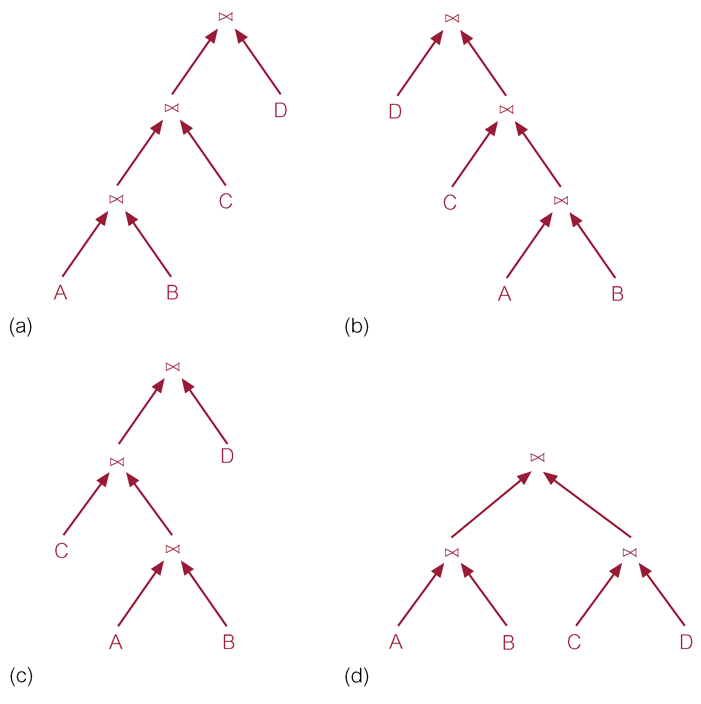
Types of Trees
© Pearson Education Limited 1995, 2005

Slide 35
Pipelining & left-deep trees
For each tuple of outer relation, need to examine entire inner relation. This inner relation can’t be pipe-lined and must always be materialized.
This makes left-deep trees (like a) appealing, because then the inner relations are always base relations.
Reduces search space for optimum strategy, and allows QO to use dynamic processing.
© Pearson Education Limited 1995, 2005

Slide 36
Physical Operators & Strategies
Physical operator
  refers to specific algorithm that implements a logical operation, such as selection or join.
For example, can use sort-merge join to implement the join operation.
Annotating a query tree with physical operators produces an execution strategy (or query evaluation plan or access plan).
© Pearson Education Limited 1995, 2005

Slide 37
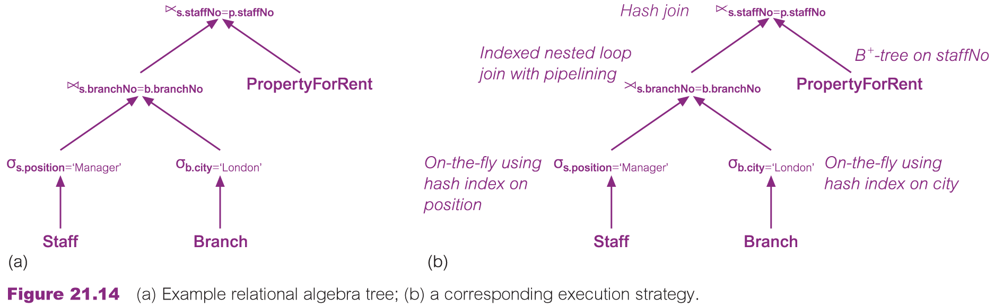
Physical Operators & Strategies
© Pearson Education Limited 1995, 2005

Slide 38
Physical Operators & Strategies
© Pearson Education Limited 1995, 2005

Slide 39
Query Optimization in Oracle
Oracle supports two approaches to query optimization: rule-based and cost-based.
Rule-based
  15 rules, ranked in order of efficiency. Particular access path for a table only chosen if statement contains a predicate or other construct that makes that access path available.
  Score assigned to each execution strategy using these rankings and strategy with best (lowest) score selected.
© Pearson Education Limited 1995, 2005

Slide 40
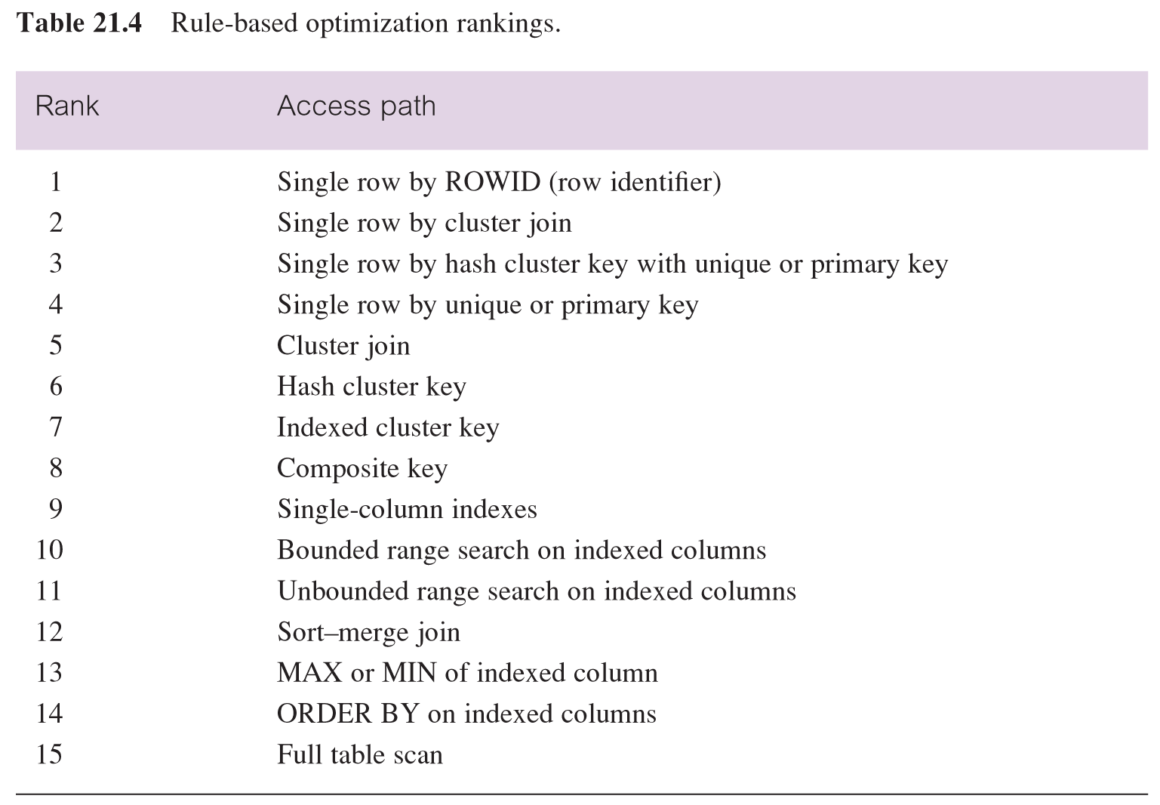
QO in Oracle – Rule-Based
© Pearson Education Limited 1995, 2005

Slide 41
QO in Oracle – Rule-based: Example
SELECT propertyNo
FROM PropertyForRent
WHERE rooms > 7 AND city = ‘London’
Single-column access path using index on city from WHERE condition (city = ‘London’). Rank 9.
Unbounded range scan using index on rooms from WHERE condition (rooms > 7). Rank 11.
Full table scan - rank 15.
© Pearson Education Limited 1995, 2005

Slide 42
QO in Oracle – Cost-Based
The cost-based optimizer selects the strategy that requires minimal resource use necessary to process all rows accessed by query
User can select whether minimal resource usage is based on throughput (producing all rows ) or based on response time (producing the first row).
The user can provide hints on decisions such as access path or join operator.
They can view the execution plan.
© Pearson Education Limited 1995, 2005

Slide 43
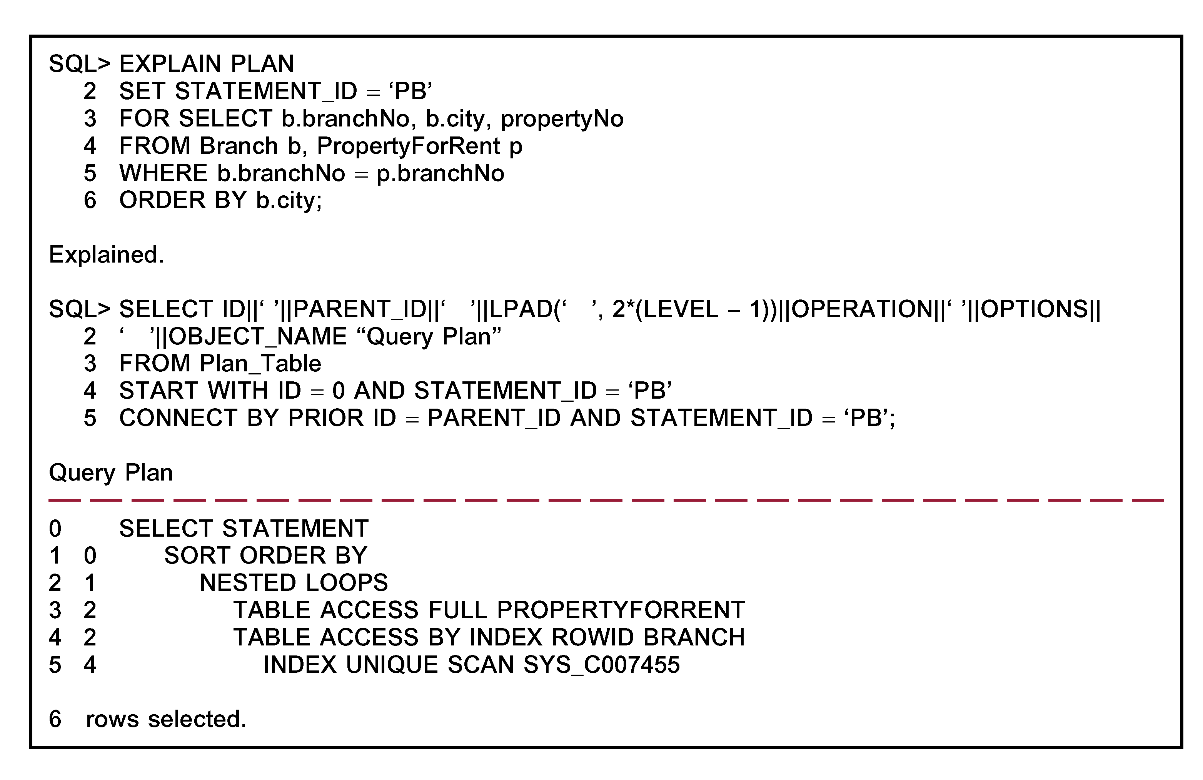
QO in Oracle – Viewing Execution Plan
© Pearson Education Limited 1995, 2005

Slide 44
QO in Oracle – Statistics
The cost-based optimizer depends on statistics for all tables, clusters, and indexes accessed by query.
It is the users’ responsibility to generate these statistics and keep them current.
Oracle uses a histogram of data values to assist decisions
© Pearson Education Limited 1995, 2005

Slide 45
Summary
Query optimization (QO) is an important task in a relational DBMS
Understanding of QO is necessary to understand the impact
  Of a given database design (relations, indexes)
  On the workload given by a set of queries
QO has 2 parts
  Enumeration of alternative plans
    Pruning of search space : left-deep plans only
  Estimation of cost of enumerated plans
    Size of results
    Cost of each plan node
Key issues – query trees, operator implementation, use of indexes

